Slide 1
Forecasting Stock Price
Drishti Chulani & Saloni Bera

Slide 2
CONTENTS
Define the project object
Data Exploration and Visualization
Model Building
Model Testing
Insights

Slide 3
Objective
The objective is to model the close price of a stock that is traded in the market based on the data given. Therefore, an appropriate model is to be developed that captures the complexities and interactions of the variables that will be decided upon and is ultimately capable of producing an accurate prediction of the close price of next day.

Slide 4
Data Exploration and Visualization

Slide 5
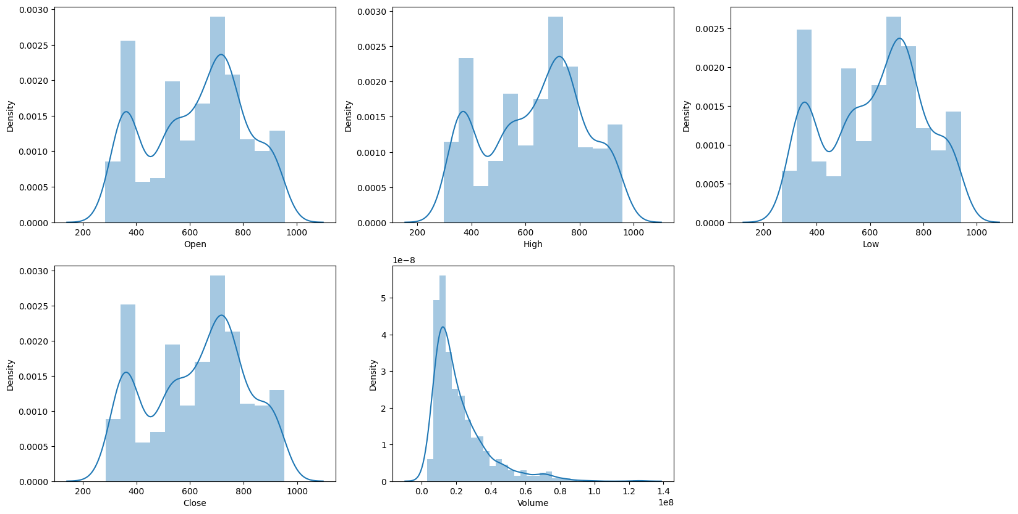
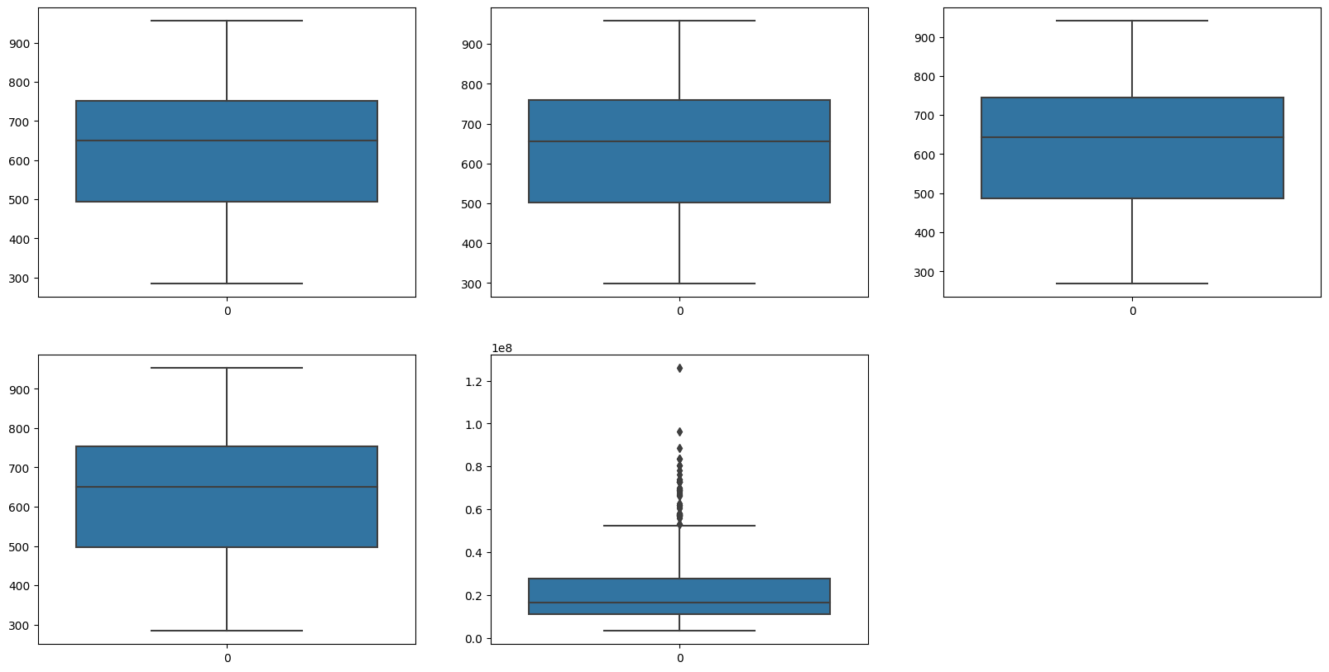
Data Understanding and Analysis
There are total 747 records and 6 variables.
First we checked the data for any missing values and studied outliers.

Slide 6
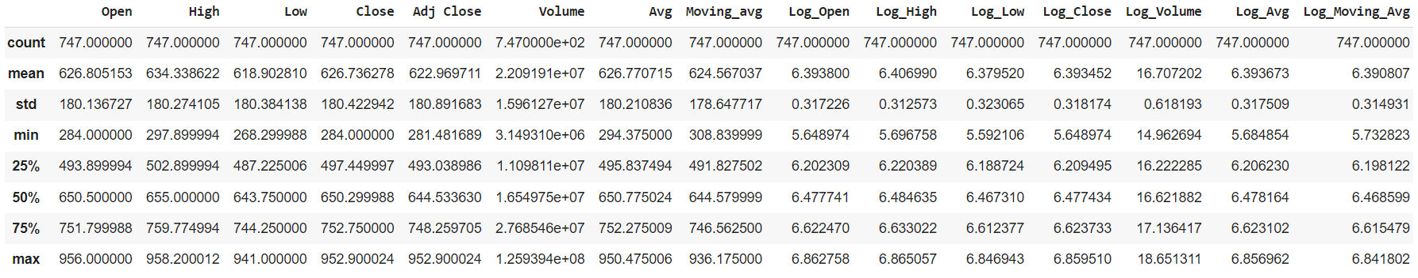
Data Understanding and Analysis
We added an average price variable and a 10-day moving average variable.
Took log of all variable – Helps in smoothening out the fluctuations

Slide 7
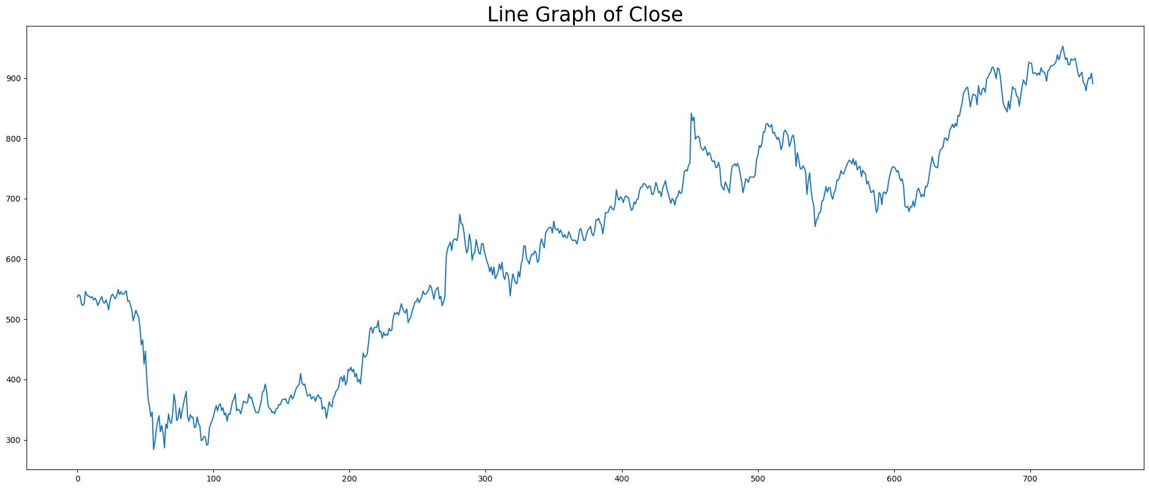
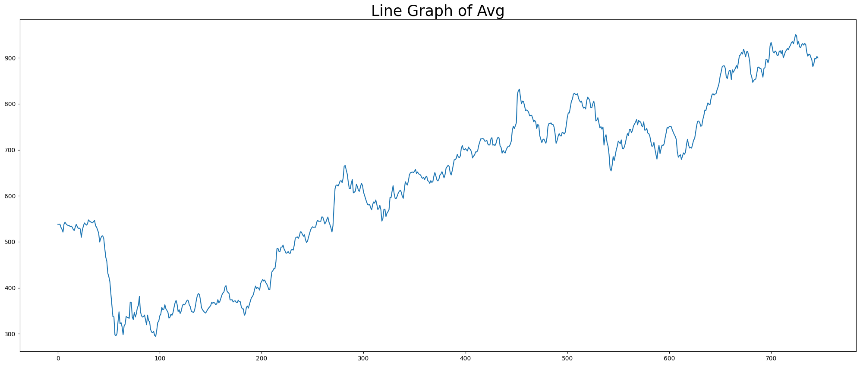
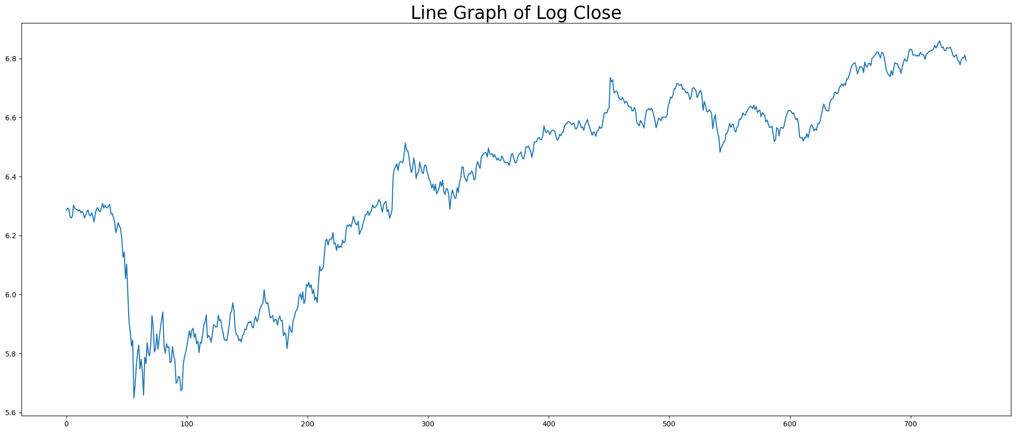
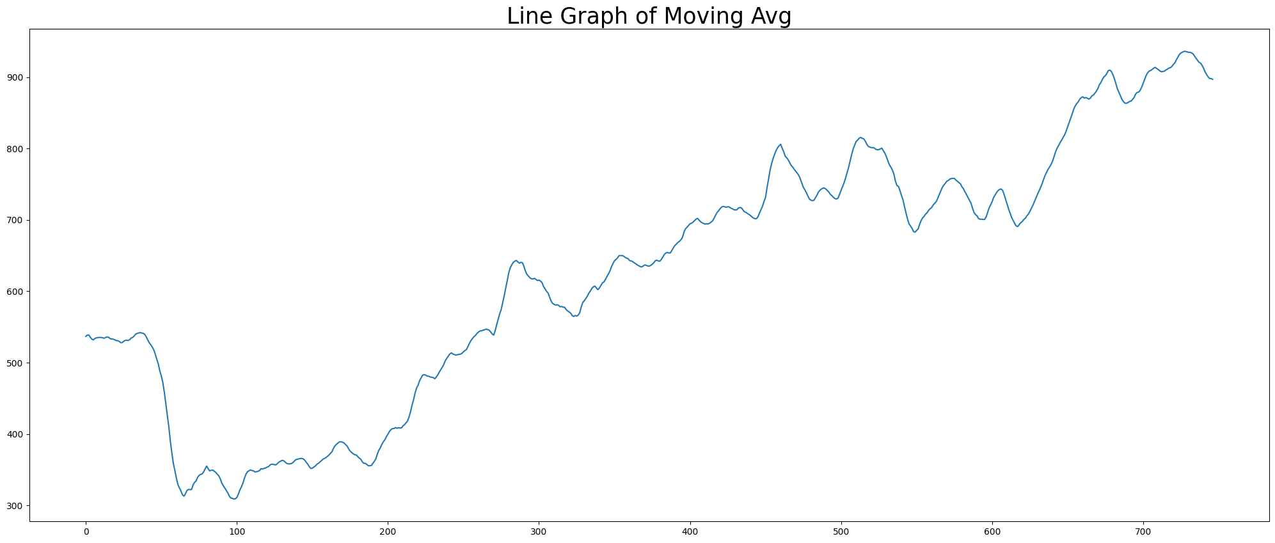
Data Understanding and Analysis

Slide 8
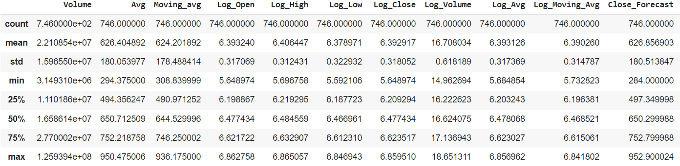
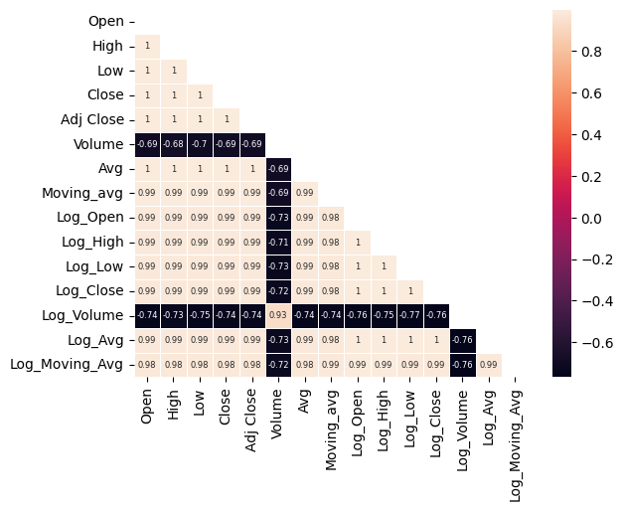
Data Understanding and Analysis
Data Description
Correlation Plot

Slide 9
Model Building

Slide 10
Linear Regression
Iteration 1 – Simple model with Close Forecast
1) X and Y Variables
3) Fitting Linear Regression
We split the variables
x = df.loc[:,['Open', 'High', 'Low', 'H-L’]]
y = df.loc[:,["Close_Forecast"]]
We fit the Linear Regression from the sklearn.linear_model library on the trainset.
Intercept: 2.93391591
Coefficient: Open: -5.20964152
High: -1.55451316
Low: 1.55451316
H-L: 1.55451316
2) Splitting the dataset
We split the dataset into train and test data in a ratio of 7:3 respectively with random state being zero.
x_train = x[:523]
x_test =x[523:747]
y_train = y[:523]
y_test =y[523:747]
4) Fitting Linear Regression
We predict the values by using the code:
y_pred = model.predict(x_test))
And make a dataframe with actual and predicted values. A sample of it:

Slide 11
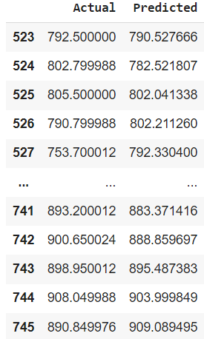
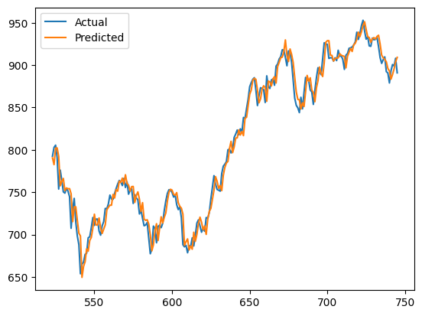
Linear Regression
Iteration 2 – Simple model with Close Forecast
Sample
Plot
Residual Analysis
Mean Absolute Error: 9.211704415825864
Mean Squared Error: 143.1640535459512
Root Mean Squared Error: 11.965118200249892
Notes:
We plot the actual values in the scatterplot denoted by grey while the red line represents the Linear Regression we have fit on the data i.e. the line of best fit.

Slide 12
Linear Regression
Iteration 2 – Log_Average
1) X and Y Variables
3) Fitting Linear Regression
We split the variables and reshape the values into an array.
X1 = df['Log_Avg'].values.reshape(-1,1)
Y1 = df['Log_CF'].values.reshape(-1,1)
We fit the Linear Regression from the sklearn.linear_model library on the trainset.
Intercept: 0.00416159
Coefficient: 0.99957594
2) Splitting the dataset
4) Fitting Linear Regression
We split the dataset into train and test data in a ratio of 6:1 respectively with random state being zero.
We predict the values by using the code:
regressor1.predict(X_test1)
And make a dataframe with actual and predicted values. A sample of it:

Slide 13
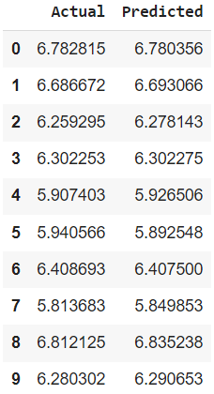
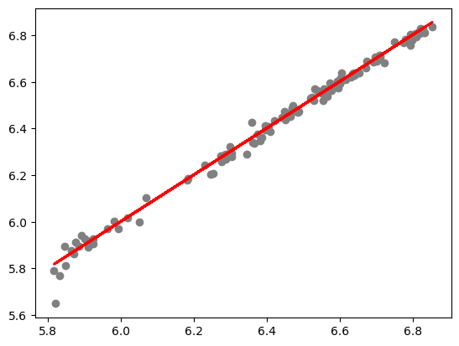
Linear Regression
Iteration 2 – Log_Average
Sample
Scatterplot
Residual Analysis
Mean Absolute Error - 0.0171196581
Mean Square Error - 0.000684524
Root Mean Square Error - 0.026163422
Notes:
We plot the actual values in the scatterplot denoted by grey while the red line represents the Linear Regression we have fit on the data i.e. the line of best fit.

Slide 14
Linear Regression
Iteration 3 – All Log Variables
1) X and Y Variables
3) Fitting Linear Regression
We split the variables and reshape the values into an array.
X=df.iloc[:,[3,4,5,7,8,9]]
Y=df['Log_CF'].values.reshape(-1,1)
We fit the Linear Regression from the sklearn.linear_model library on the trainset.
Intercept: 0.05092244
Coefficients : Log_Open = -1.02900531e+00
Log_High = 2.27677539e-01
Log_Low = 2.55522500e-01
Log_Volume = -1.03836330e-03
Log_Avg = 1.49061286e+00
Log_Moving_Avg = 5.02947703e-02
2) Splitting the dataset
We split the dataset into train and test data in a ratio of 6:1 respectively with random state being zero.
4) Fitting Linear Regression
We predict the values by using the code:
regressor.predict(X_test)
And make a dataframe with actual and predicted values. A sample of it:

Slide 15
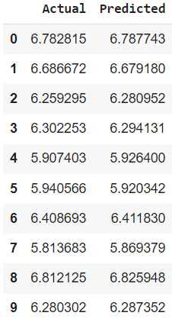
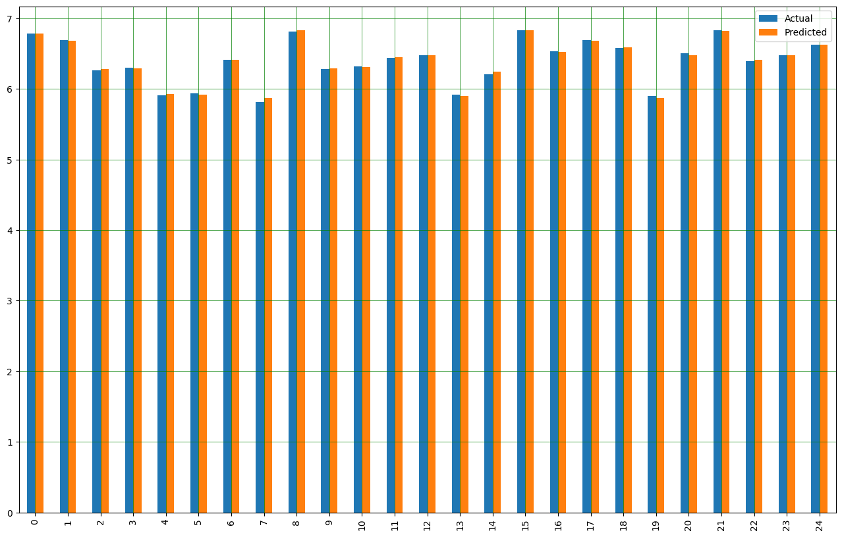
Linear Regression
Iteration 3 – All Log Variables
Sample
Barplot
Residual Analysis
Mean Absolute Error - 0.01640306
Mean Square Error – 0.00084225
Root Mean Square Error - 0.02902167
Notes:
We plot the actual values in the scatterplot denoted by grey while the red line represents the Linear Regression we have fit on the data i.e. the line of best fit.

Slide 16
Linear Regression
Iteration 4 – All Log Variables except Log_Avg & Log_Moving_Avg
1) X and Y Variables
3) Fitting Linear Regression
We split the variables and reshape the values into an array.
x=df.iloc[:,[3,4,5,7]]
y=df['Log_CF'].values.reshape(-1,1)
We fit the Linear Regression from the sklearn.linear_model library on the trainset.
Intercept: 0.05092244
Coefficients : Log_Open = -0.62500528
Log_High = 0.79655673
Log_Low = 0.82173495
Log_Volume = -0.00181307
2) Splitting the dataset
We split the dataset into train and test data in a ratio of 6:1 respectively with random state being zero.
4) Fitting Linear Regression
We predict the values by using the code:
regressor.predict(x_test)
And make a dataframe with actual and predicted values. A sample of it:

Slide 17
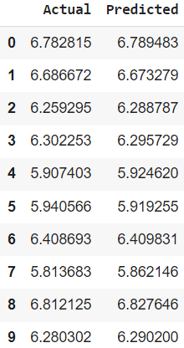

Linear Regression
Iteration 4 – All Log Variables except Log_Avg & Log_Moving_Avg
Sample
Barplot
Residual Analysis
Mean Absolute Error - 0.017477
Mean Square Error – 0.0008363
Root Mean Square Error - 0.028919
Notes:
We plot the actual values in the scatterplot denoted by grey while the red line represents the Linear Regression we have fit on the data i.e. the line of best fit.

Slide 18
Ridge, Lasso & Elastic
Tests show not much difference between the two iterations, we finalize our iteration 2 as final model with lower RMSE.
Ridge
Lasso
Elastic Net
Penalizes the sum of squared coefficients or large regression coefficients.
Elastic Net combines the penalties of ridge and lasso.
Theory
Adds a penalty for coefficients instead.
Python
Code
ridgeR = Ridge()
ridgeR.fit(x_train, y_train)
ridgeR.predict(x_test)
Lasso = Lasso(alpha=0.1)
Lasso.fit(x_train, y_train)
Lasso.predict(x_test)
elastic = ElasticNet(alpha=0.1)
elastic.fit(x_train, y_train)
elastic.predict(x_test)
Error
terms
MSE: 0.000731
RMSE: 0.027045
MSE: 0.06313
RMSE: 0.25126
MSE: 0.032627
RMSE: 0.180630

Slide 19
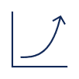
Insights
Stock market is too volatile; hence the presence of the outliers is justified.
A new variable “Average”, which is the average of open and close prices, is added .
New variable known as “moving average” is added to smoothen the fluctuations in the data.
Log of all variables to bring the values in similar range.
Iteration 4 is the best suited model after Comparing the MSE and RMSE

Slide 20
THANK YOU
Drishti Chulani
Saloni Bera

